Slide 1

G
B
I
S
E.Rishwanth Reddy Ch. Sumanth
K.Nivas Teja
GESTURE BASED INPUT SYSTEM

Slide 2
Table of Contents
Abstract
Goal & Steps to reach goal
Introduction
Screenshots
Problem Description
Future Scope of Work
System Requirements
Conclusion
Activities in Project
Reference

Slide 3
Abstract
Hand gesture recognition in aspect to human machine interface is being developed vastly in recent days. Because of the disturbance of lighting and background being not plain, many visual hand gesture recognition systems operate or show successful results only in restricted background

Slide 4
Introduction
Gesture Based Input System
With the development in Computer Vision and Human Machine Interaction the Computer holds most important role in our daily life. Human Computer Interaction can provides several advantages with the introducing the different natural forms of device free communication

Slide 5
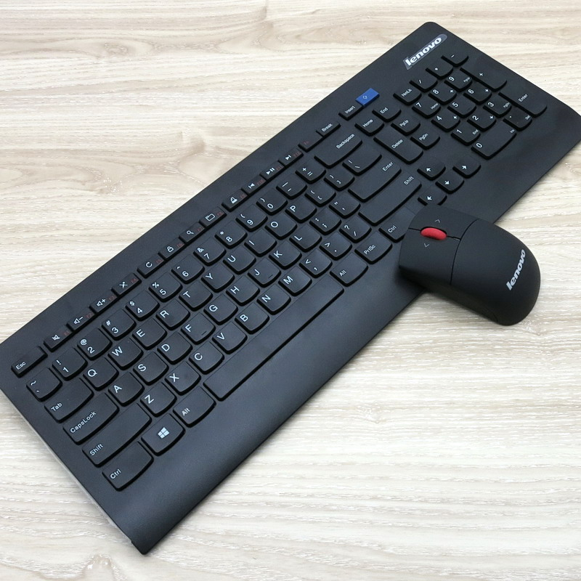
Problem Description
Gesture based input system is a new way to interact with computer system unlike traditional input devices (Keyboard and mouse). Webcam is used to recognize users hand based his/her gestures necessary system operations are performed like play/pause music, play games, virtual keyboard etc.

Slide 6
System Requirements
Hardware Requirements
Software Requirements
Minimum of 8GB RAM(16GB recommended)
i5/ryzen5 or higher CPU
2GB dedicated GPU or higher
PC running windows 7 or higher OS
Python(version 3.5 or above)
Open CV
Keras
Numpy
Pygame
Packages
Languages
Python

Slide 7
Activities in Project
Created a Region of interest(ROI)
Capture the background
Create a background mask
Use threshold energy to create binary
Capture Data
Produce Action

Slide 8
To develop a deep learning algorithm to classify hand gestures using Convolutional Neural Networks based on TensorFlow and Keras
GOAL
OF
THIS
PROJECT

Slide 9
Load Dataset
Steps to reach our goal
Train & Test Model
Using Hand Gesture Recognition Database dataset from Kaggle (7 hand gestures + above 1000 images ), we follow a series of steps to eliminate noise, unnecessary space and background.
Using concept of Linear Regression our model is trained and tested.
Webcam Integration
System Integration

Slide 10

Convolutional Neural Networks
Convolutional layers
Pooling Layers
Dense Layers
A Convolutional Neural Network is a Deep Learning algorithm which can take in an input image, assign importance (learnable weights and biases) to various aspects/objects in the image and be able to differentiate one from the others.

Slide 11

Webcam Integration
Webcam is integrated to our application using Open CV. Then we separate background from foreground using b key on keyboard. Prediction is made by pressing p key and based on the prediction specific operation is performed in our case media player operations.

Slide 12

System Integration
The Software is integrated with the System. And the passed signals from the trained model will be used to perform the required Operation to the User.
Example: VLC Media Player software is able to play the videos, pause and we can increase and decrease the volume while playing the video etc.

Slide 13
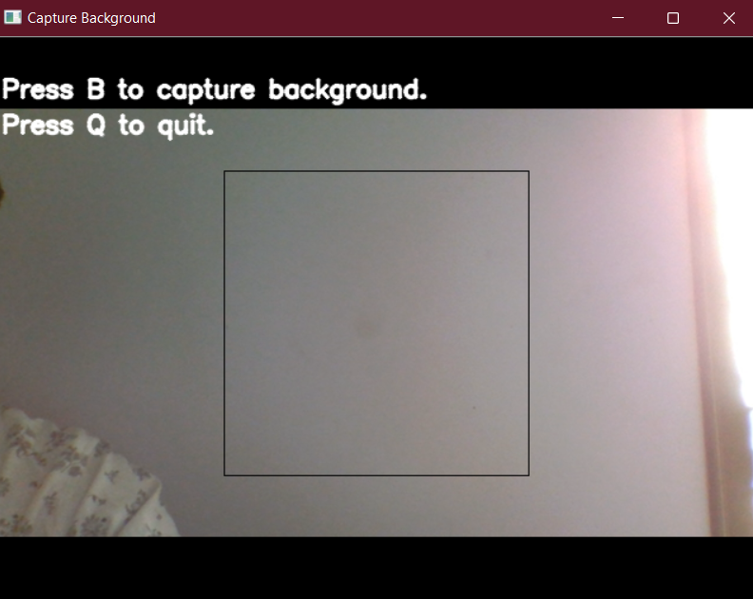
Screenshots
Capturing and masking background

Slide 14
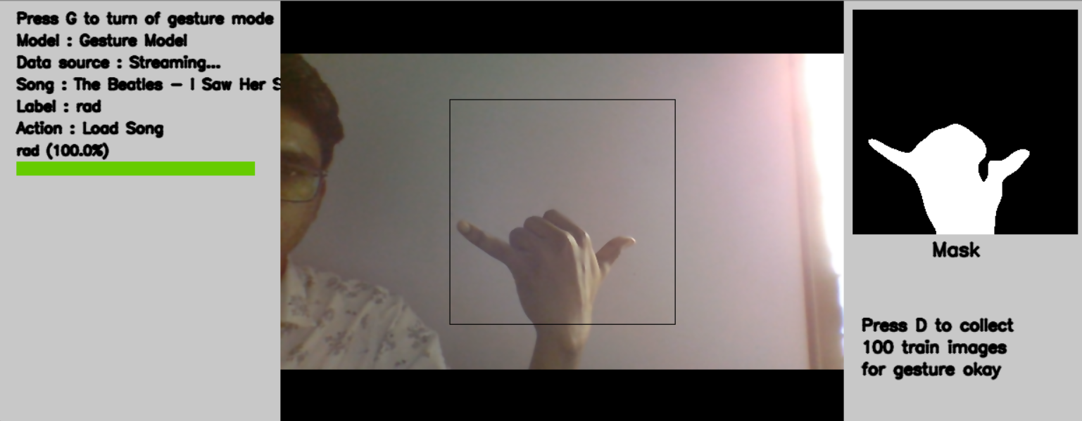
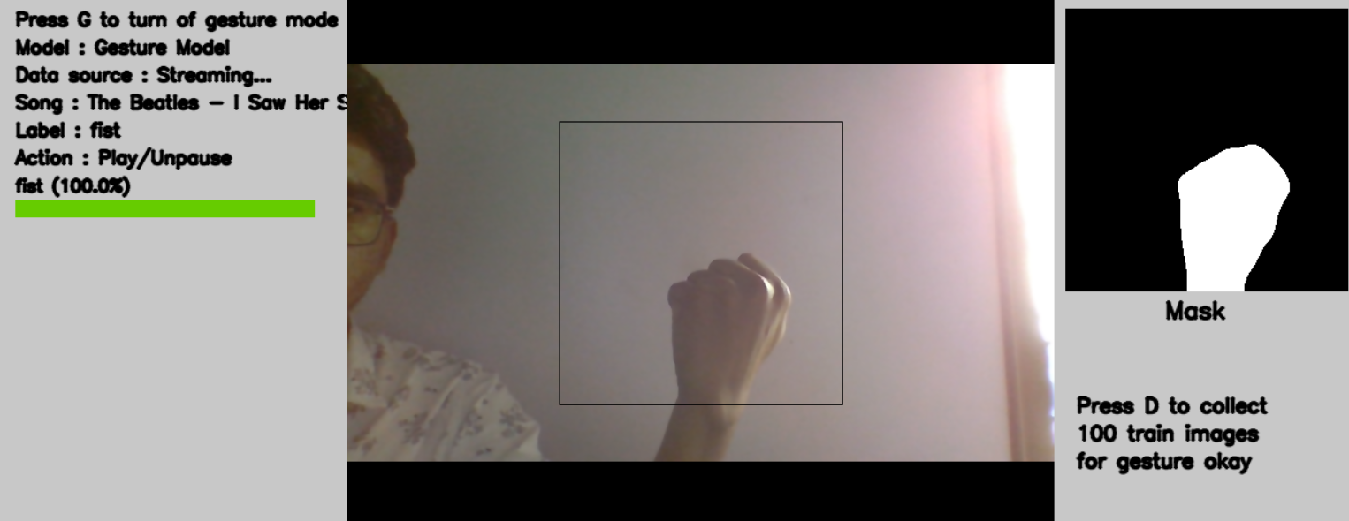
Gesture: RAD
Function: Loads song
Gesture: FIST
Function: Starts song

Slide 15
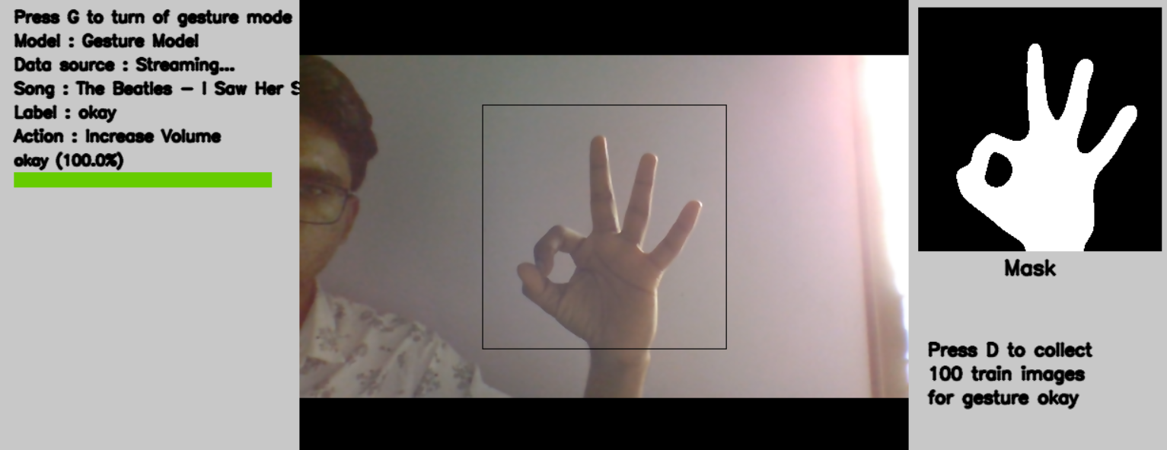
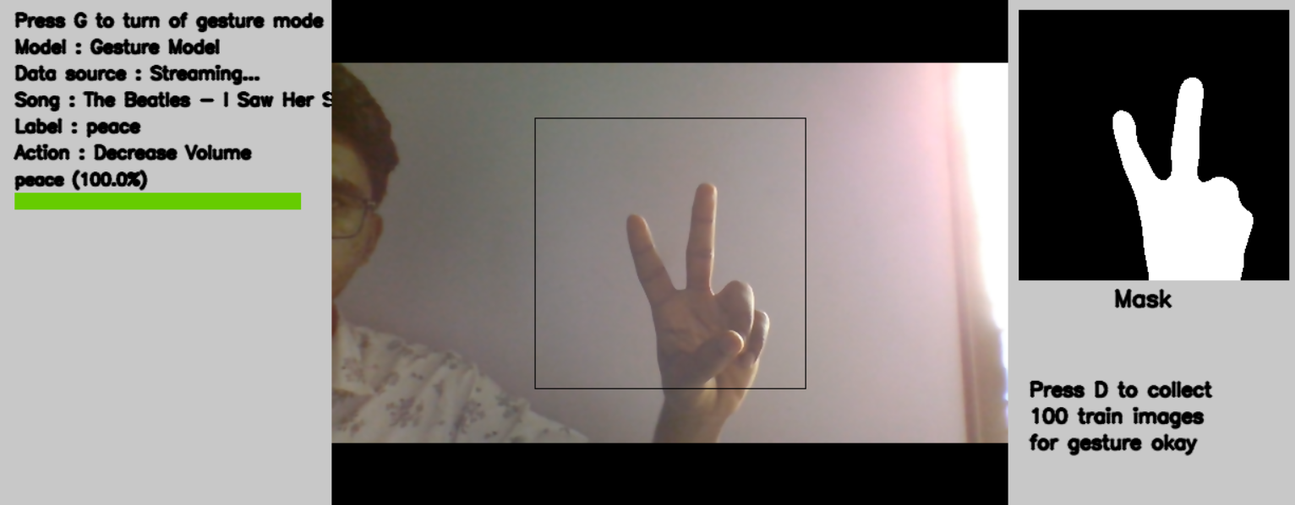
Gesture: OKAY
Function: Increase Volume
Gesture: PEACE
Function: Decrease Volume

Slide 16
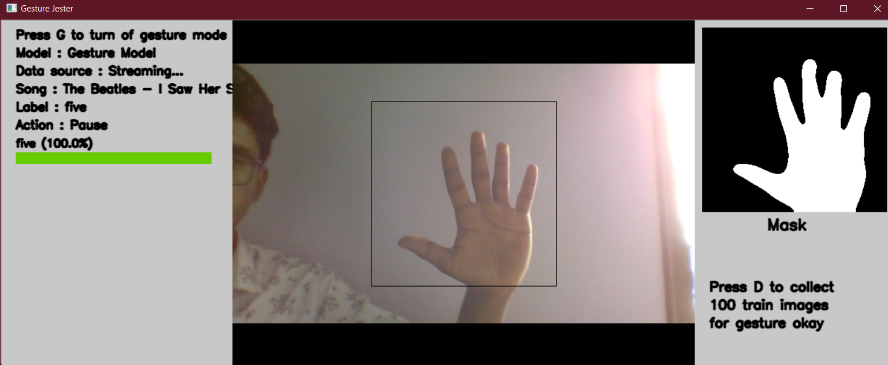
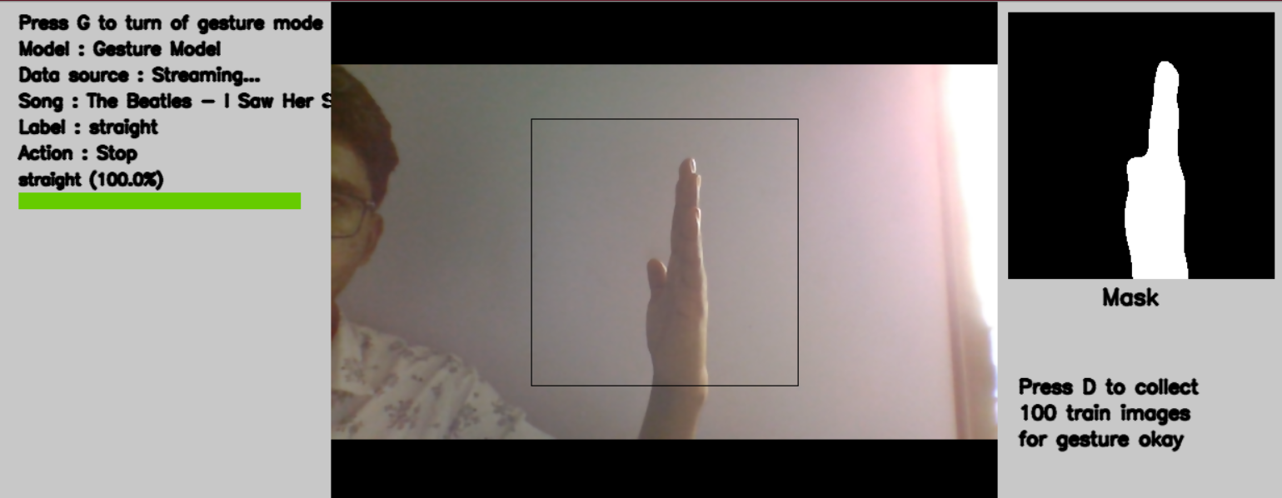
Gesture: OKAY
Function: Pause song
Gesture: STRAIGHT
Function: Stops Song

Slide 17
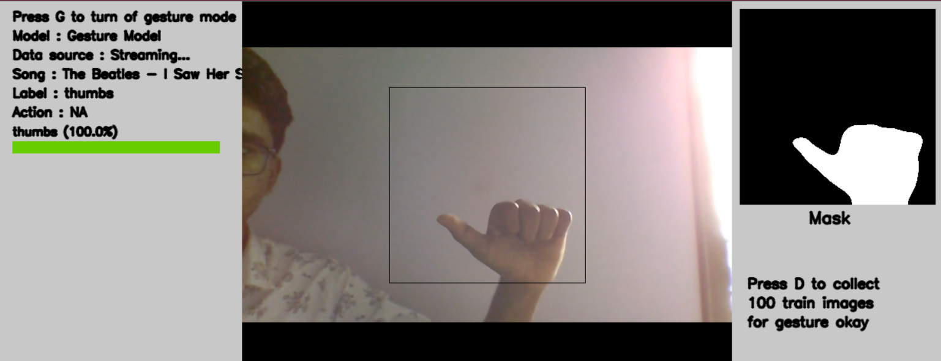
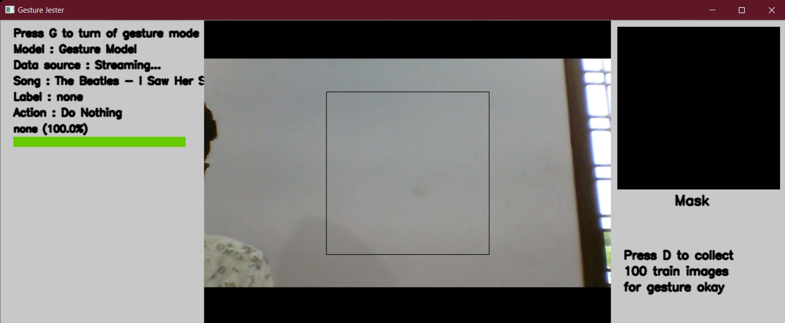
Gesture: THUMB
Function: Does Nothing
Gesture: NONE
Function: Does Nothing

Slide 18
Conclusion
Gesture Based Input System
Through this System a user can interact with the computer easily without any traditional devices like Keyboard, Mouse and etc. future development can be made to recognize face gestures so even disabled people can easily interact with computers.

Slide 19

References
Google, medium
Kaggle Dataset
CNN Documentation
Open CV and autogui

Slide 20

QUERIES?

Slide 21

Thank you
GBIS

